Slide 1


CONSTRUCTION AND DEVELOPMENT THE CLO
HERE IS WHERE YOUR PRESENTATION BEGINS

Slide 2

01
IDEA AND BUSINESS PLAN
02
WEBSITE DESCRIPTION
03
TABLE OF CONTENTS
CONCLUSION
04
TEAM WORKING PROCESS

Slide 3
IDEA & BUSINESS PLAN
TABLE OF CONTENTS

Slide 4
SURVEY MARKET
IT platforms
Over 66% Vietnamese access Internet. It is a opportunity to easily and cost-effective access customers.
Demand
Fashion is an essential commodity for women
BUYER JOURNEY
Decision
Clothing rental and exchange services

Slide 5


ABOUT US
THE CLO is the sharing economy platform for fashion. THE CLO allows users to pay a fixed monthly fee to use and experience fashion products without owning.

Slide 6
BUSINESS GOALS
Constantly updated with trends
Increase visibility, interaction
SALES FUNNEL
Receive feedback
Data collection

Slide 7
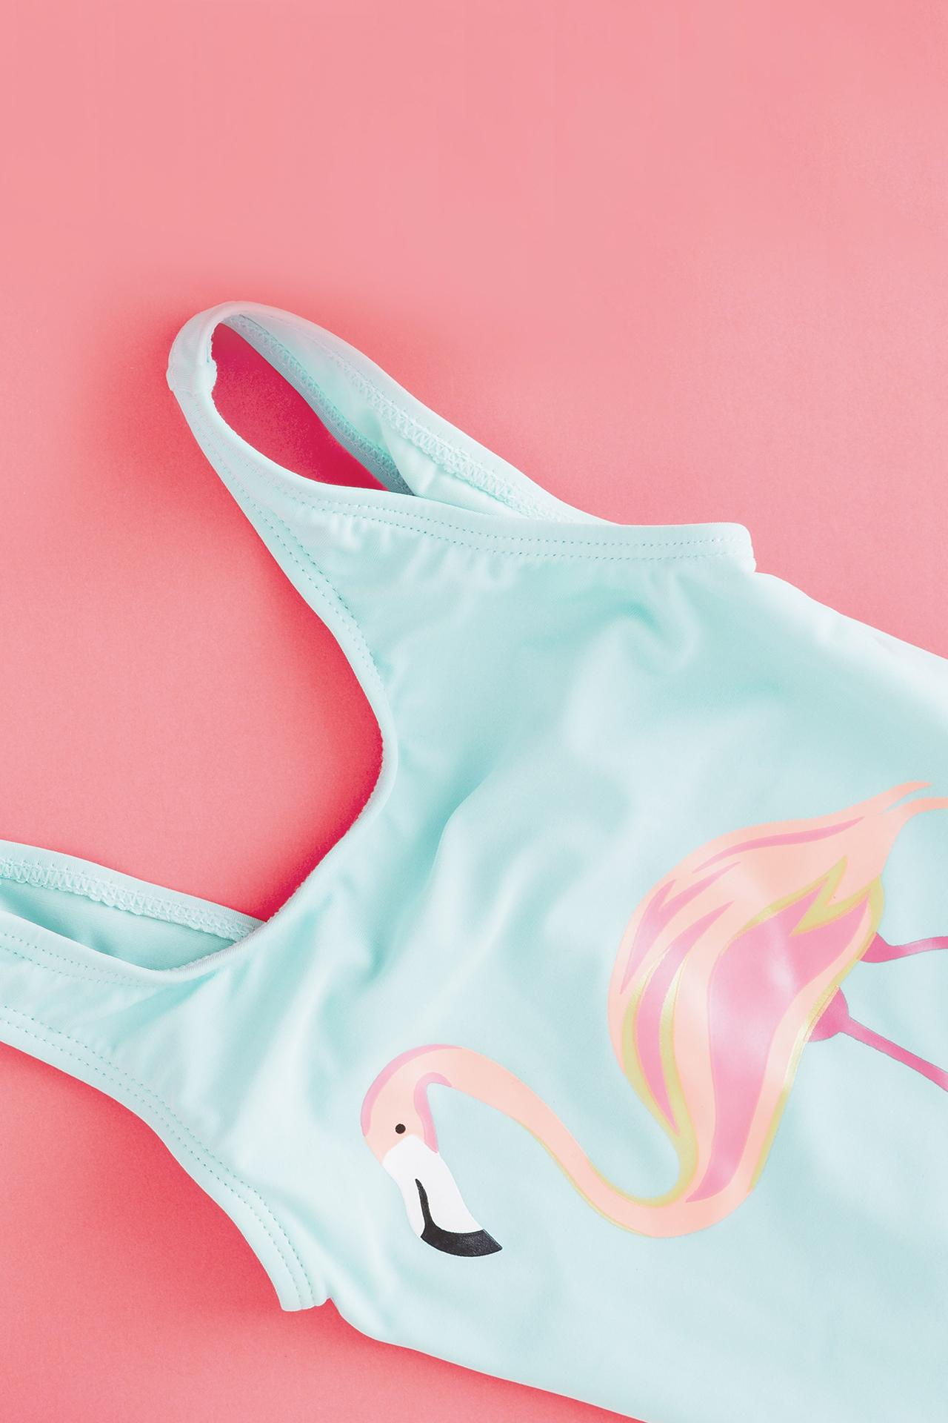
ABOUT THE FIELD & PRODUCT
The main products being traded are costumes through the exchange of "hot" costumes which are chosen by many people.
ABOUT THE PRODUCT

Slide 8
MARKET ANALYSIS
Market size
Growth rate
Market trend
Expanding in Vietnam is not easy for both foreign and domestic firms.
2019 is $ 5.6 billion, expected growth of 8.8%
"Penetration" of many international names, domestic brands are also growing.
1
2
3
Customer's location
Court of law
Demographic
Just do business registration procedures
young people who are economically self-reliant.
TP.HCM, TP.HCM, Da Nang, Hai Phong, Hanoi
4
5
6
OUR EVOLUTION

Slide 9
SWOT ANALYSIS
New model
high potential customers
Diverse marketing channels
Associated with brands
Creating sympathy
Needs of ages and
professions
S
W
O
T
Damaged products
Newly established,
small scale
Demand for using the service is high
Compete with cheap clothes

Slide 10
COMPETITIVE ADVANTAGE
Sản phẩm
Gía
Phân phối
Phân khúc KH
IT
Gía trị
THE CLO
Major fashion brands
Rental stores, secondhand stores

Slide 11

Business models
analysis

Slide 12

CUSTOMER SEGMENTS
workers, freelancers, singers,…
KEY PARTNERSHIPS
Brand, KOL, model, shipment, laundry, IT,…
VALUE PROPOSITIONS
reducing environmental pollution
COST STRUCTURE
Clothing, laundry, shipment, IT, management,..
REVENUE STREAM
Subscription membership
Buys the product again
KEY ACTIVITIES
Internet, Data,…

Slide 13
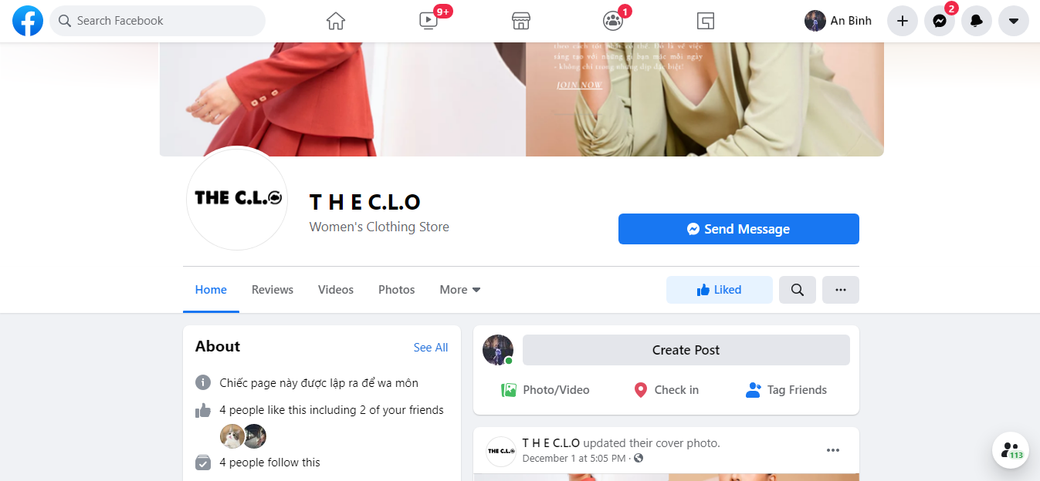

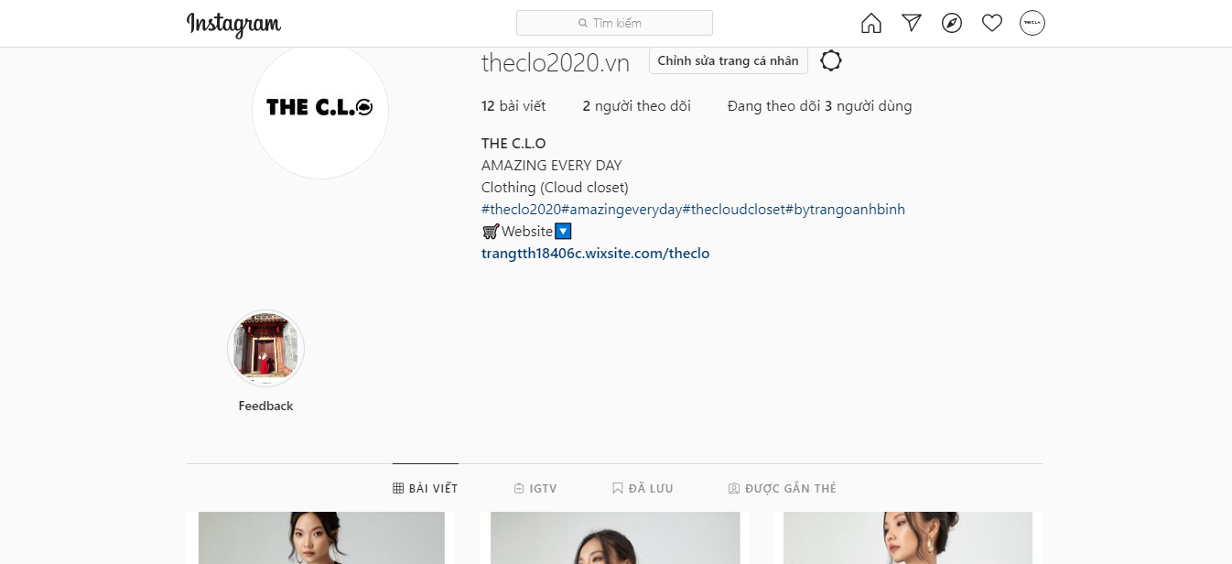
CHANNELS
OUR EVOLUTION

Slide 14
KEY RESOURCES
FAN PAGES
APP
WEBSITE
Customers can register for membership and manage personal information, orders, ...
Advertising the brand as well as supporting customers with answers and advice
Access and manage certain pieces of information.

Slide 15
MARKETING MIX(4P)
Product
Diverse in colors, styles, suitable for many styles, ...
CORE VALUES
Place
A big city
Price
Apply to product marketing strategy
Promotions
SEO, Mobile marketing, website,...

Slide 16
WEBSITE DESCRIPTION
TABLE OF CONTENTS

Slide 17


Slide 18
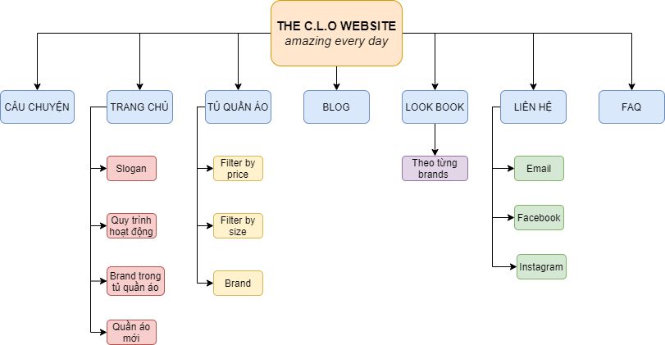
WEBSITE STRUCTURE

Slide 19
CONCLUSION
TABLE OF CONTENTS

Slide 20
PROJECT EVALUATION
COMPETITOR ANALYSIS
Result
Advenatge
Disaventage
Applied all the knowledge learn
Improve skills in searchingdocument
Many resources
Many people interested
Having a certain understanding of the market, economics as well as current technologies.

Slide 21
Using virtual reality technology
Expading a B2B model
Segment of “PRO” accounts
BUDGET
Expading a scope activity
Implementing and developing ERP system
DEVELOPMENT

Slide 22
TEAM WORKING PROCESS
TABLE OF CONTENTS

Slide 23
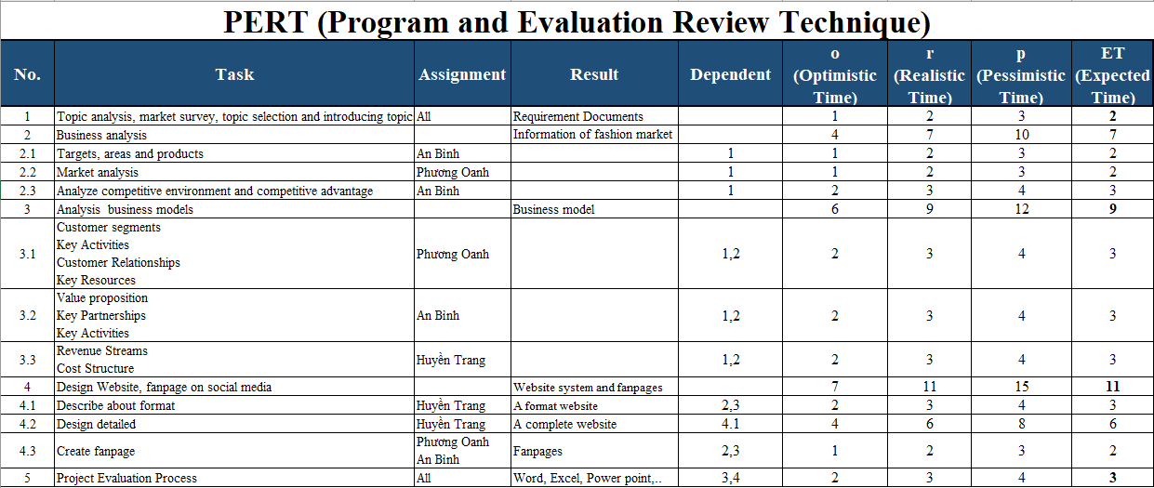


JENNA DOE
HELENA JAMES
OUR TEAM
You can replace the image on the screen with your own
You can replace the image on the screen with your own

Slide 24
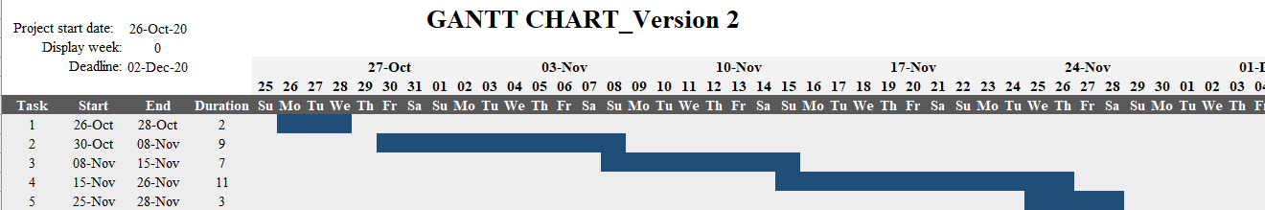
GOALS
GOAL 1
Jupiter is the biggest planet in our Solar System
GOAL 3
Mercury is the closest planet to the Sun
GOAL 2
Despite being red, Mars is a cold place, not hot
GOALS
GOAL 4
Venus has a beautiful name, but it’s terribly hot

Slide 25

THANKS
THANKS
Does anyone have any questions?

